Slide 1


Mentor-mentee recommendation system
Yana Ponomarova

Slide 2
Find yourself a mentor from the pole of Enron professionals
Enron Corporation is an American energy, commodities, and services company based in Houston, Texas.
Our professionals are actively involved in mentoring activities for youth and they would be happy to help. Find your mentor in two steps: fill the form with the keywords of skills researched and press Go!
http://193.70.6.96:8000/

Slide 3

Mentor description: Enron emails

Slide 4
Enron emails
Mentor description: Enron emails

Slide 5
Mentor description: Topics of Enron emails
Legal
Administrative
Trade
Gas market specifics
All related to gas and energy

Slide 6
Mentor Representation
Method 1: Sum of vectorized emails they have written
Method2: Distribution of topics

Slide 7
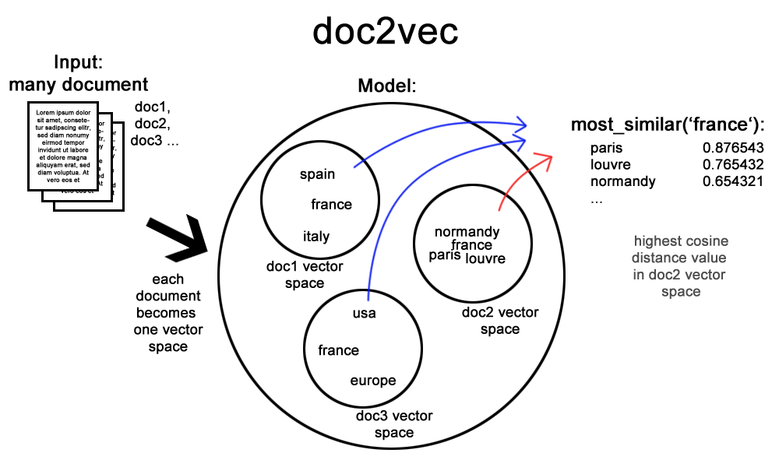
Method 1: Doc2Vec

Slide 8
Method 1: Doc2Vec evaluation criteria
Sanity check:
Similarity (x, y) < similarity (x,x)
Similarity to gas
nymex | postid | calpin energi servic | midland cooper | neglig | smurfit | natur ga futur contract | nortwest | nymex rule | immatur
0.41 | 0.40 | 0.39 | 0.38 | 0.38 | 0.38 | 0.38 | 0.38 | 0.38 | 0.37
the most extensive and liquid energy marketplace with energy futures, options contracts | Position id? | Calpine Energy Services, L.P. manages power and gas assets for wholesale customers in North America | Midland Cooperative Oil Association |  | Smurfit Kappa is a business in the field of sustainable energy | Natural Gas future contracts | NorthWestern Corporation owns NorthWestern Energy, a utility company that serves South Dakota, Nebraska, and Montana | Marketplace rules

Slide 9
Method 1: Doc2Vec evaluation criteria
most similar to “energy” and least similar to “trade”
most similar to “energy” and “trade”
promin | em | extravag | default rate | whiskey | pulp produc | jewish | contract mdq | cdwr deal | lockhe
0.37 | 0.36 | 0.34 | 0.34 | 0.33 | 0.33 | 0.33 | 0.32 | 0.32 | 0.32
Tool in Energy & Resource Development | Electromagnetic energy | Energy Extravaganza is a summit on sustainable energy |  |  | Pulp production (associated business line) |  | MDQ is a Maximum Daily Quantity is the quantity of gas a customer can request or take under a contract on any one day | CDWR is a California's Department of Water Resources | Lockheed Martin is a global security and aerospace company with extensive energy sustainability agenda
salad | liar | instituion | ga asset | broadband servic | emiss allow | coastal | erron | project socal ga dynegi phibro txu engag wesco | commerci manag market
0.41 | 0.38 | 0.38 | 0.37 | 0.37 | 0.37 | 0.37 | 0.37 | 0.37 | 0.36
 | Are traders known as liars? :-) |  | gas assets | likely clients business (energy consuming) | environment legislation | Coastal Energy Company engages in the exploration, development, and production of oil and gas properties in Thailand | typo? | SoCalGas - primary provider of natural gas to Southern California. TXU - Texas Electricity Company. Wesco Energy - full service home heating supplier | Commercial management market

Slide 10
Method 1 : Recommendation
Get vector representation of all emails + mentee description (Doc2Vec)
Find emails that are most closely related to mentee description (keyword list) : cosine similarity
Group similarity score by email author
Propose top most relevant authors for mentoring

Slide 11
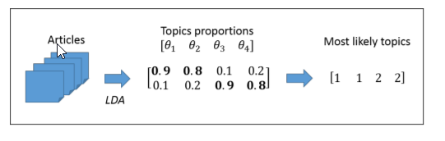
Method 2: LDA

Slide 12
Method 2: LDA evaluation criteria
Perplexity
Meaningfulness of topics
Finally, K = 13

Slide 13
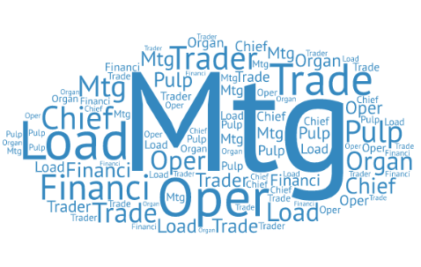
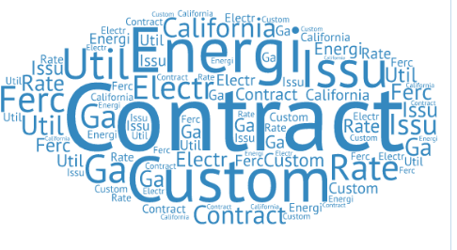
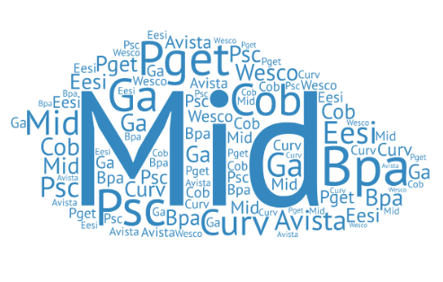
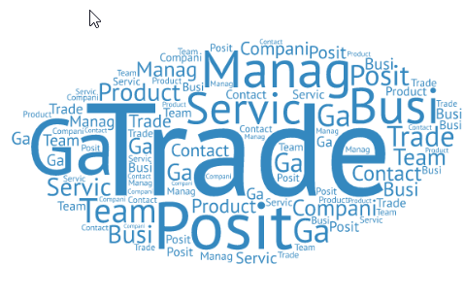
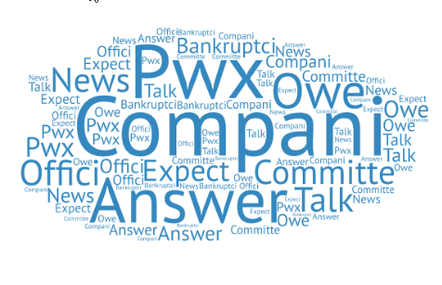
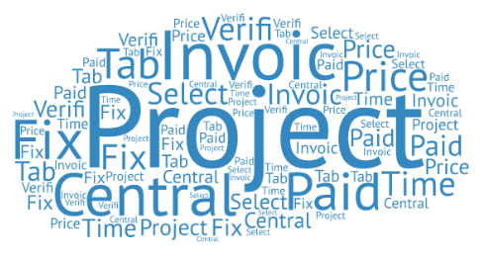
Method 2: LDA Topics

Slide 14
Method 2 : Recommendation
Get distribution of emails across topics (LDA)
Get the distribution of mentee interests across the topics (LDA), take topics with score >0.5
Find emails that contain the above 2 topics in their vectoral representation
Group similarity score by email author
Propose those authors for mentor role

Slide 15
Interesting findings
Everything is about gas and trade
Not surprising, given that «Enron Corporation was an American energy, commodities, and services company based in Houston, Texas» - Wikipedia
Email vector representation:
Models with chunks + tokens > model with chunks > model with tokens
TFIDF > CountVectorizer
Spark implementation of LDA lack predictive functions

Slide 16
Alternative methods
Clustering on top of Doc2Vec
Collaborative filtering

